Slide 1

Turning

Slide 2
Housekeeping
60 minutes
Emergency exit, toilet, kitchen

Slide 3
Aim
The aim of this briefing is to teach you how to conduct turns during level flight, climbing and descending at a varying angle of bank.

Slide 4
Motivation
Maintain the aeroplane in a balanced and safe attitude.
Advance your ability to coordinate the aeroplane’s directional situation.
Ultimately navigate to a destination efficiently.

Slide 5
Overview
Objectives
Revision
Definitions
Types of turns
Forces acting in a turn
Factors affecting a turn
Application
Airmanship & TEM
Summary
Objectives – revisited

Slide 6
Objectives
At the end of the briefing, you will be able to, from memory and without mistake:
State what component of lift provides the Centripetal force in a level turn.
State in what type of turn would you experience the tendency to overbank.
State what the effect would be on the stall speed with an increase in angle of bank.

Slide 7
Revision
Types of descent
Forces acting in a descent
Factors affecting the descent

Slide 8
Definitions
Bank angle
The angle between an aeroplane’s lateral axis and the horizon.

Slide 9
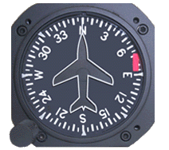
Definitions
Heading
Direction of the aeroplane’s nose in relation to north in a clockwise direction as indicated on the compass.
Notes:
The number is one-tenth of the cardinal degree.

Slide 10
Definitions
Rate of turn
The number of degrees of change in heading per second.

Slide 11
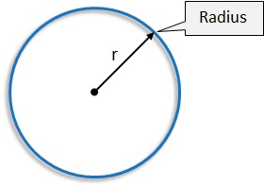
Definitions
Radius of turn
The distance between the aeroplane and the centre of the turn.

Slide 12
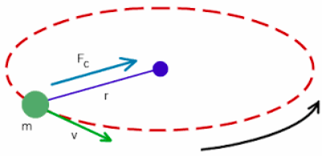
Definitions
Centripetal force
Force that causes an object to follow a circular path.
Centripetal means centre seeking or towards the centre.

Slide 13
Definitions
Load factor
The ratio of lift to the weight of an aeroplane. The units in which load factor is expressed as “g” i.e. Force.

Slide 14
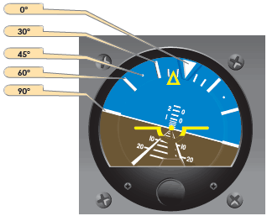

Types of turns
Shallow turn 15$°$ AoB
Medium turn 30$°$ AoB
Steep turn >30$°$ AoB
Used in climbing turns
Used in descending turns

Slide 15
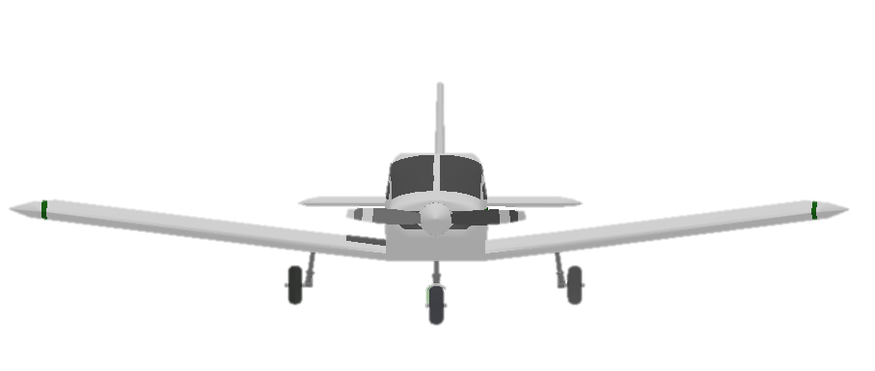
Forces acting in a turn
L
W
Notes:
In straight and level flight, lift balances to weight.

Slide 16
Forces acting in a turn
Weight = Vertical component Lift
Horizontal component lift: Centripetal Force
Vertical component Lift
L
Horizontal component Lift
W
30°
Notes:
During a level turn the necessary centripetal force is supplied by banking the aeroplane, thus ‘tilting’ the lift component.
The vertical component of lift will be too small to balance weight and the aeroplane will descend.
To maintain the level flight, the angle of attack must be increased in order to create more lift as the Angle of Bank increases.

Slide 17
Factors affecting a turn
Overbank / Underbank
Balance
Adverse yaw
Load factor

Slide 18
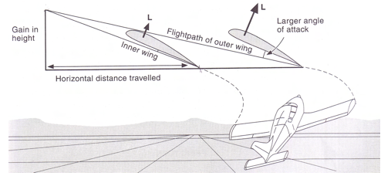
Factors affecting a turn – Overbank
The tendency to overbank is sometimes evident during level and climbing turns due to outer wing travelling faster than the inner wing.
Notes:
Outer wing travelling faster than inside wing ,AOA higher. thereby creating more lift on the outside wing with the result that the aircraft wants to keep rolling into turn.
Increase AoA PLUS Increase v on outside wing – greater overbanking tendency than in the level turn

Slide 19
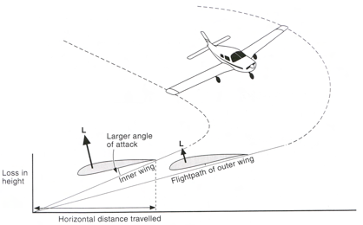
Factors affecting a turn – Underbank
The tendency to Underbank is sometimes evident during descending turns where the angle of attack of the outer wing is lower than the inner wing.
Notes:
Underbank : once in turn the wing wants to turn it back to level off. Most common in descending, we need keep roll wings to the turn
AOA HIGHER inside wing, but airspeed is lower than outside wing. Result that the aircraft tries to keep rolling out of the turn.
U might require some aileron in to the turn

Slide 20
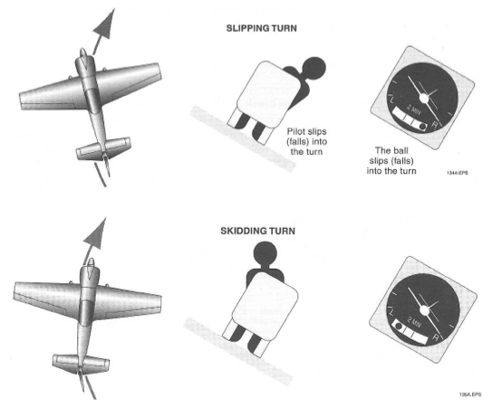
Factors affecting a turn – Balance
Nose pointed outside the turn
Nose pointed inside the turn
Notes:
Step on the ball
As with all other stages of flight, the rudder must be used to keep the aeroplane balanced.

Slide 21
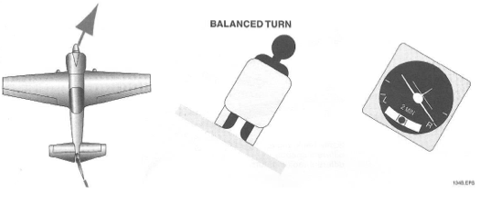
Factors affecting a turn – Balance
Nose pointed in the direction of turn

Slide 22
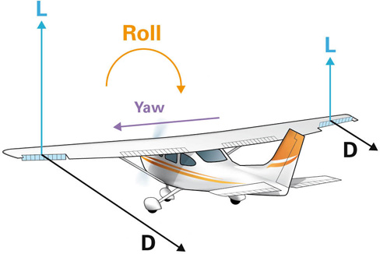
Factors affecting a turn – Adverse yaw
Notes:
Difference between the lift generated by down going wing compared to up going wing. Result of the increase in lift produced by up going wing, as well as drag, this will yaw the nose of the aeroplane in the opposite direction to the turn
There are design feature employed that assist in counteracting this tendency to yaw away from the direction of the turn and they are:

Slide 23
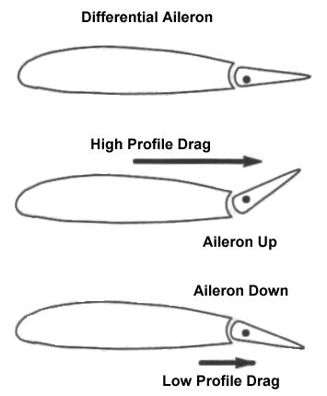
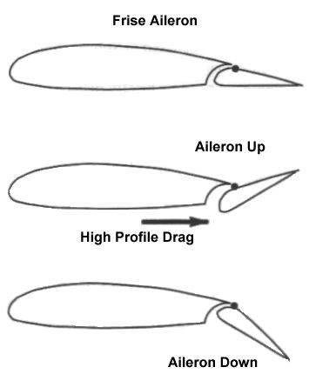
Factors affecting a turn – Adverse yaw

Slide 24
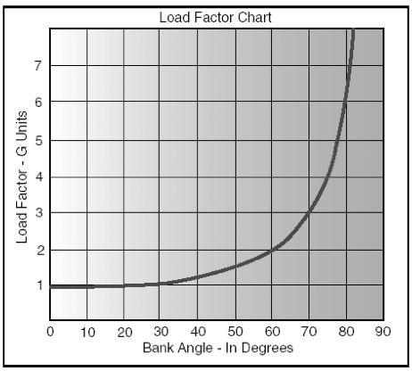
Factors affecting a turn – Load factor
Load factor = Lift / Weight

Slide 25

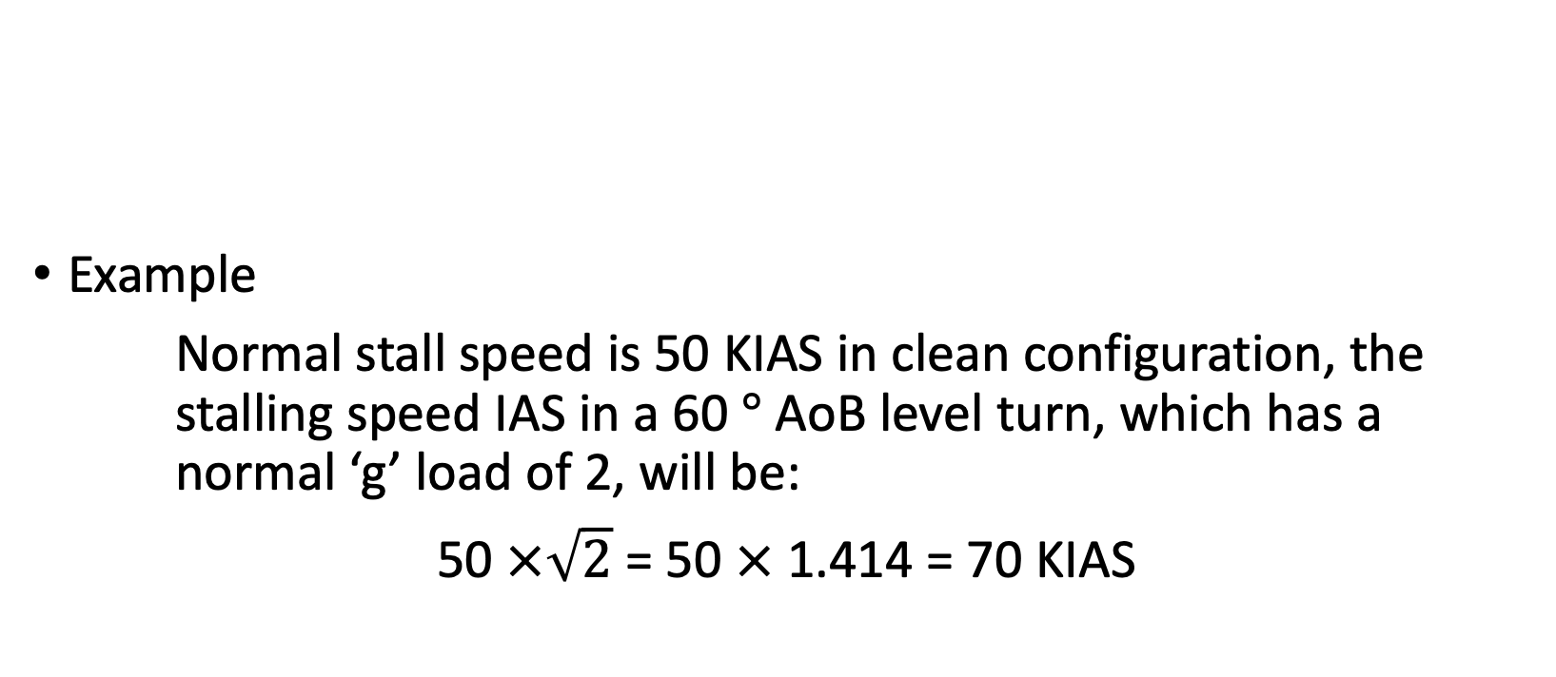
Factors affecting a turn – Load factor
Example
Normal stall speed is 50 KIAS in clean configuration, the stalling speed IAS in a 60 $°$ AoB level turn, which has a normal ‘g’ load of 2, will be:
50 $×\sqrt{2}$ = 50 $×$ 1.414 = 70 KIAS

Slide 26

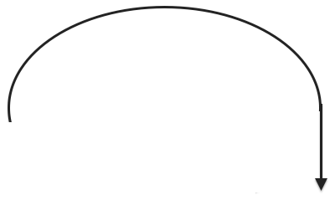
Application – Level turn
Maintain
Attitude
Lookout
Attitude
Performance
CCHAT
Entry
Bank
Balance
Back Pressure
Exit
Anticipate
Bank
Balance
Back Pressure
Pre-Entry
Reference point
Carby heat off
Mixture full rich
T and P
Lookout
Notes:
Anticipate the roll out by 10° heading change
Use coordinated rudder, aileron to return the aircraft to the straight and level attitude.
window

Slide 27

Application – Climbing turn
AoB max 15 $°$
Entry
Power
Attitude
Speed
Trim
Bank
Balance
Back Pressure
Maintain
Attitude
Lookout
Attitude
Performance
CCHAT
Exit
Anticipate
Bank
Balance
Back Pressure
Anticipate
Attitude
Speed
Power
Trim
Pre-Entry
Reference point
Carby heat off
Mixture full rich
T and P
Lookout
Notes:
Consider rudder:
Right rudder on climb
Left rudder to enter left turn
Overbank tendency
Exit depends on which reference is reached first ( heading or height)
window

Slide 28
Application – Descending turn
Entry
Power
Attitude
Speed
Trim
Bank
Balance
Back Pressure
Maintain
Attitude
Lookout
Attitude
Performance
CCHAT
Exit
Anticipate
Bank
Balance
Back Pressure
Power
Attitude
Speed
Trim
Pre-Entry
Reference point
Carby heat off
Mixture full rich
T and P
Lookout
Notes:
Underbank tendency
Exit depends on which reference is reached first ( heading or height)
window

Slide 29
Airmanship
Clearing the turn from opposite direction
Limit bank angle – Overbank & Underbank
Smooth control inputs

Slide 30
Threat and error management
Threat | Error | Management | UAS
Traffic |  | Check outside to inside Use ALAP | Air proximity event
Stall | Excessive AoB |  | Loss of control
Loss of SA | Losing reference point | Choose prominent reference point Anticipate the roll out
Failure to clear turn
Make turns within
AoB limits
Disorientation

Slide 31
Summary
Types of turns
Forces acting in a turn
Factors affecting a turn

Slide 32
Objectives – revisited
State what component of lift provides the Centripetal force in a level turn.
State in what type of turn would you experience the tendency to overbank.
State what the effect would be on the stall speed with an increase in angle of bank.

Slide 33

The End

